Slide 1
Equinix Customer Portal April 2025 Release (2025.4)
Impact Analysis and Training Overview
Updated on 7 Mar 2025

Slide 2
Zoom recordings
Zoom recordings of sessions held by ECP PMs will be included here when available:
Session 1 recording link:
https://equinix.zoom.us/rec/share/5tPT2RXCYL-SPBS8ejYdIlrbkNzi9Vlkm0M3pNIKknqw1xdm-H-fraox8Z5Q_jfl.9bsdkIVqZVY_Pf6P
Passcode: +*Q2pR6p

Slide 3
Equinix Customer Portal – ECP/CSC
High-level Scope and What’s New, Known Limitations
ECP Global Feature | New Capabilities | Known Limitations | PM POC
Cross Connect | Logic amendment for the CC orders placed by GSD – For Orders of more than $1000 MRC/NRC, additional approval is required from customer. | Descoped from April due to complexity of implementation and limited such records | Sonalee Panda
Cross Connect | Patch Panel Search in the start of the ordering form & showing the values in the provider Table | Descoped from April | Sonalee Panda
Cross Connect | Moving the Extended CC Card from "Upload DLOA/Standard Card" to "Order without LOA & Adding Verbiage with to the respective card | Descoped from April – Plan is to change the verbiage rather than moving the card under a different tile | Sonalee Panda
Cross Connect | Additional message for the DLOA users " No need for paper LOA upload" in the form |  | Sonalee Panda
Cross Connect | User experience enhancement in the contact page – for selection of values in the "Best Time to Call" |  | Sonalee Panda
Cross Connect | Enabling the package detailed View in Portal | Data Issue on existing records – Will be part of April patch once the data correction is completed | Sonalee Panda
Cross Connect | Sunset of Classic experience for the Internal Orgs |  | Sonalee Panda
Inventory/Install Base | Updated Siebel to ECP data attribute mapping for ECX00002.ELEM Fabric Connection, ECX00003.ELEM Fabric Service Provider, ECX00008.ELEM Fabric Remote Connection, ECX00015.ELEM Fabric Virtual Connection assets |  | Jia Yuan Goh (JY)
Note: 1st round language translation at Go Live; 2nd round translation 3 weeks after Go Live.

Slide 4
Equinix Customer Portal – ECP/CSC
High-level Scope and What’s New, Known Limitations
ECP Global Feature | New Capabilities | Known Limitations | PM POC
Operator | Allow alphanumeric search in Operator’s Order Number Search (Post April Release) | Alphabets cannot be entered into search box | Adrian Goh
Order History | Update default behaviour when landing on Orders & Tickets History page (Post April Release) |  | Adrian Goh
Equinix Intelligence | Pilot Launch for 20 customer organisations |  | Adrian Goh
Hiding IBX pricing | Following feedback from the APAC team on the MRC price decreases released on April 1st, users will no longer be able to see MRC/kVA pricing for all IBXs on the IBX selection step |  | Andrew Smith
Only increasing MRC on MACDS | Following feedback from the APAC team on the MRC price decreases released on April 1st, when performing a MACD users will no longer be able select draw capacities that reduce the MRC of their deployment |  | Andrew Smith
Allow 1kVA draw capacity increments | Following feedback from the APAC team on the MRC price decreases released on April 1st, when performing a MACD users will only be able to select draw capacities in increments of 1kVA |  | Andrew Smith
Note: 1st round language translation at Go Live; 2nd round translation 3 weeks after Go Live.

Slide 5
Impact Assessments by Feature Set

Slide 6
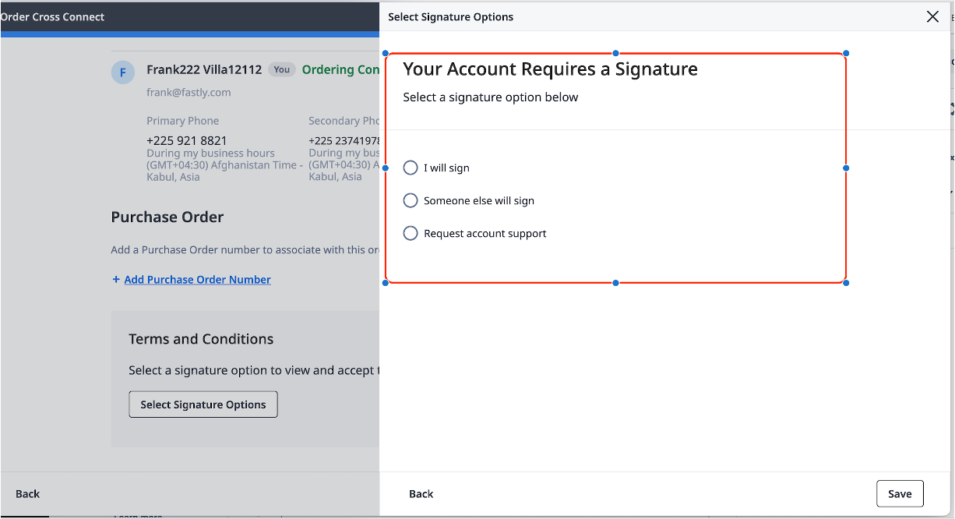
Cross Connect – Operator Portal Logic for Orders more than $1000 (MRC/NRC)
DESCOPED FOR NOW
ECP/ Operator | Module | Detail | Training & process change
Operator |  | For Orders of more than $1000 MRC/NRC, additional approval is required from customer. When GSD places the order from operator portal for non -signature required accounts, the above logic will be applied. These orders will flow through the signature required account flow from portal | CSM Awareness GSD awareness Ops Support awareness Sales/AE awareness

Slide 7
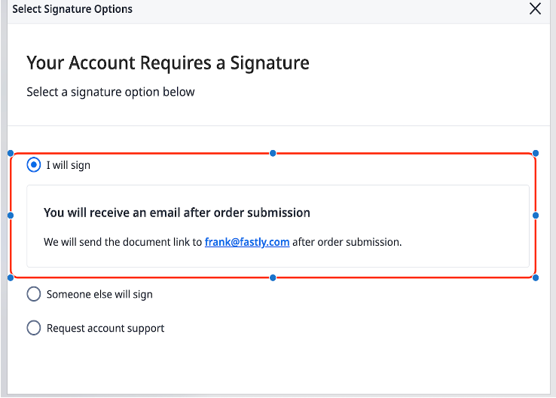
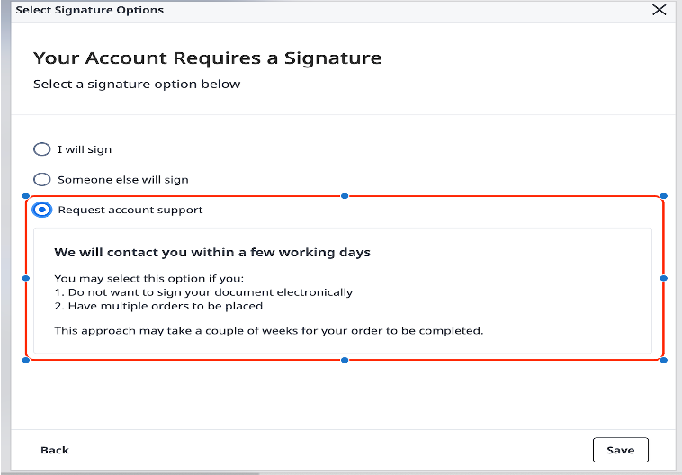
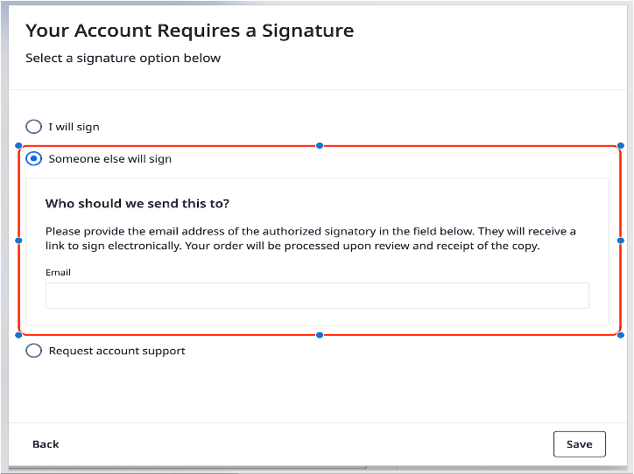
Cross Connect – Operator Portal Logic for Orders more than $1000 (MRC/NRC)
DESCOPED FOR NOW
ECP/ Operator | Module | Detail | Training & process change
Operator | CC ( Signature Flow) | Signature Required Flow Details (For NON signature Accounts + Orders more than $1000 MRC/NRC) I will Sign Someone else will sign Request Account Support | CSM Awareness GSD awareness Ops Support awareness Sales/AE awareness

Slide 8
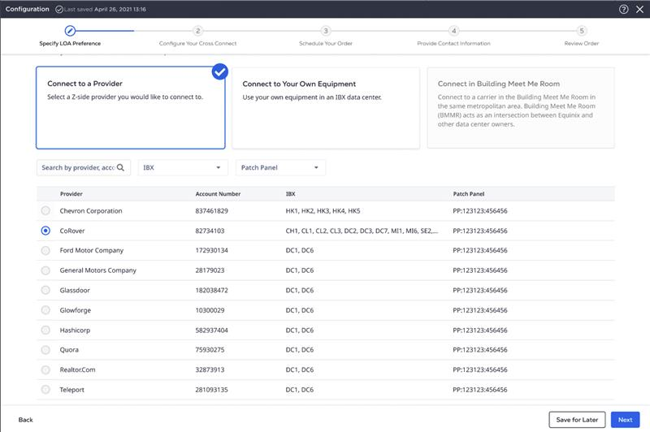
Cross Connect – Patch Panel Search/Filter in UI
DESCOPED FROM APRIL – Will update the revised release
ECP/ Operator | Module | Detail | Training & process change
ECP/Operator |  | Customer Feedback : Searching with patch panel value along with provider name, IBX details provides more accurate information & faster results Patch Panel Filter in the CC ordering form (first page) Patch Panel values to be added to the Provider Table | CSM Awareness GSD awareness Ops Support awareness Sales/AE awareness

Slide 9
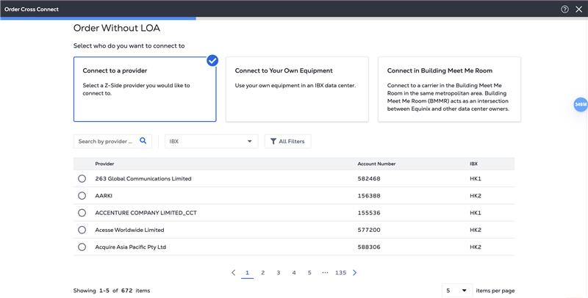
Cross Connect – Moving Extended CC Under CC
DESCOPED FOR NOW – We are looking into updating the Verbiage rather than moving the card under a different tile
ECP/ Operator | Module | Detail | Training & process change
ECP/Operator | Cross Connect | Moving the Extended Cross Connect Under the Single Card – Order Without LOA This provides a better customer experience & navigation to the single work flow | CSM Awareness GSD awareness Ops Support awareness Sales/AE awareness

Slide 10
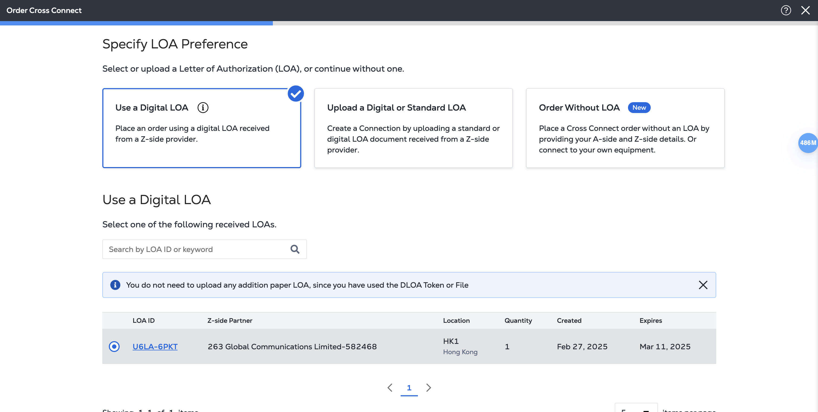
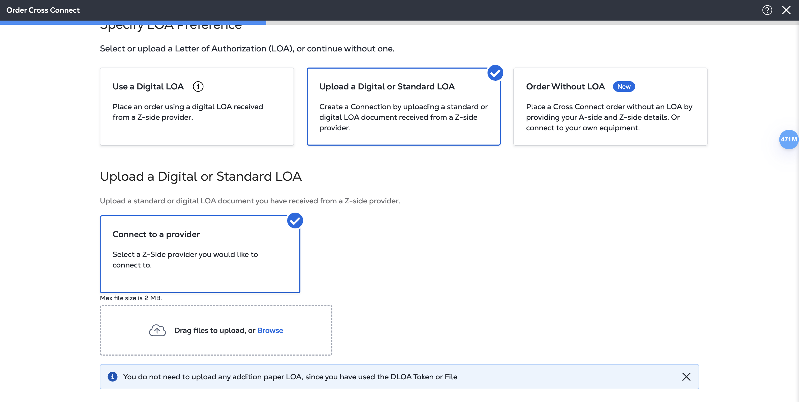
Cross Connect – Message Display for DLOA Token/File Upload
ECP/ Operator | Module | Detail | Training & process change
ECP/Operator | Cross Connect | User Feedback: Will show additional message for DLOA Token use or DLOA File Upload Once user proceeds with either of these route – the message will be displayed "Not to upload any more paper LOA" for these Orders | CSM Awareness GSD awareness Ops Support awareness Sales/AE awareness

Slide 11
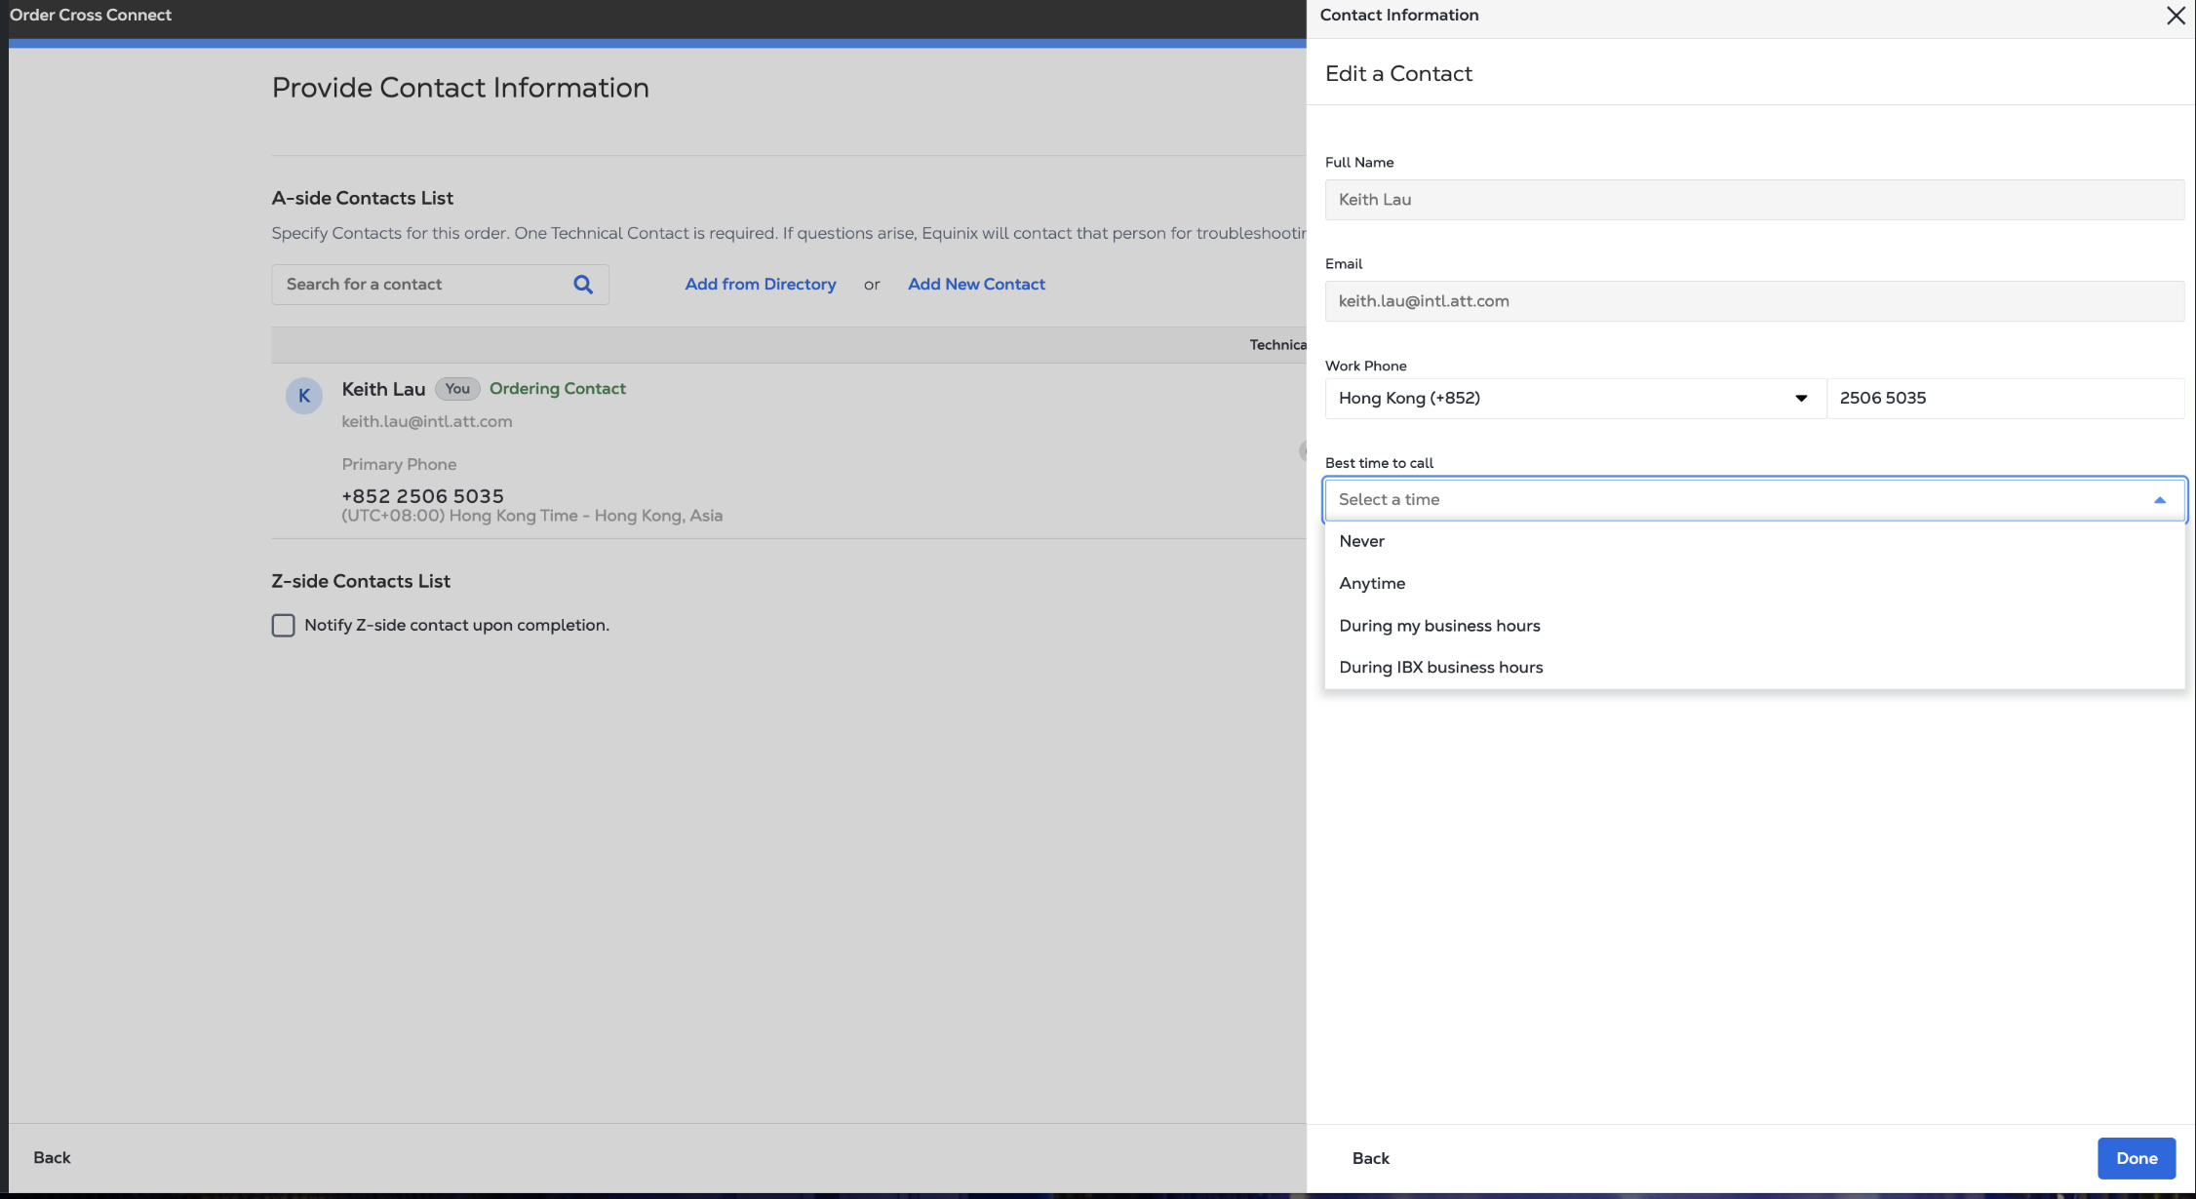
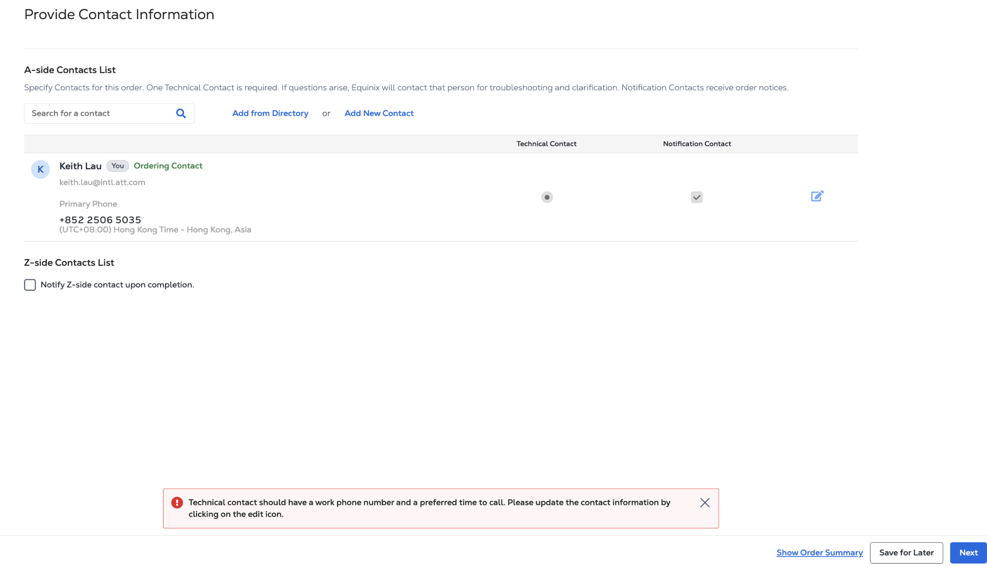
Cross Connect – Enhance Customer Experience for Contact Page
Error message will display here if user does not select the value
This message section will be removed
ECP/ Operator | Module | Detail | Training & process change
ECP/Operator | Cross Connect | By default, the user should see the contact update widget to select “best time to call” rather than clicking on edit and landing in this page. If user do not select any value from the field best time to call, then should see the error message adjacent to the field itself. “please select a value” User should not see the message at the bottom of the page, after clicking on Next. | CSM Awareness GSD awareness Ops Support awareness Sales/AE awareness

Slide 12
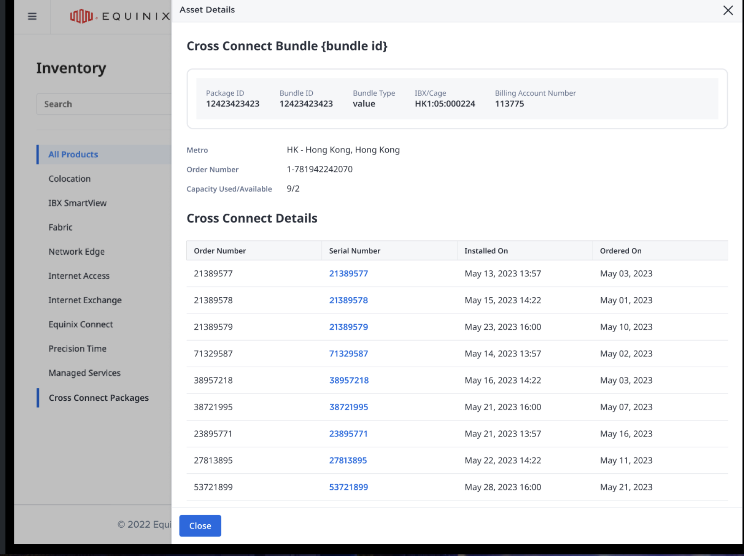
Cross Connect – Package Dashboard detailed View – Patch Release
Due to Data error in the existing records, this feature can be deployed to production once confirmed by Billing team about the data correction – Target is by end of May 25 (Part of Patch Release)
ECP/ Operator | Module | Detail | Training & process change
ECP/Operator | Cross Connect - Inventory - Package | User can access the detailed view of the package. This will provide the insight of individual cross connect orders associated with the package. | CSM Awareness GSD awareness Ops Support awareness Sales/AE awareness

Slide 13
Cross Connect – Internal Orgs – Sunset of Classic Experience
ECP/ Operator | Module | Detail | Training & process change
ECP/Operator | Cross Connect - Classic CC Sunset | Classic CC Sunset of the Internal Orgs We provided co existance experience – In the scenario of back up customer support | CSM Awareness GSD awareness Ops Support awareness Sales/AE awareness

Slide 14
Inventory/Install Base: Fabric assets data attribute mapping
‘Bandwidth’ label was inaccurate and created confusion for customers for following Fabric Assets.
Summary of changes made to Siebel to ECP data attribute mapping:
 | Siebel Attribute | Inventory UI | Inventory Report | Install Base UI | Install Base Report
ECX00002.ELEM Fabric Connection | Rate | No change - kept mapping to Rate | Unmapped from Bandwidth Kept mapping to Rate (No change) | No change | Unmapped from Bandwidth
ECX00003.ELEM Fabric Service Provider | Rate | No change - kept mapping to Rate | Unmapped from Bandwidth Kept mapping to Rate (No change) | No change | Unmapped from Bandwidth
ECX00008.ELEM Fabric Remote Connection | Rate | No change - kept mapping to Rate | Unmapped from Bandwidth Kept mapping to Rate (No change) | No change | Unmapped from Bandwidth
ECX00015.ELEM Fabric Virtual Connection | Connection Speed | Unmapped from Bandwidth Added ’Billing Tier’ label & map it to Siebel’s ‘Connection Speed’ | Unmapped from Bandwidth Added ’Billing Tier’ label & map it to Siebel’s ‘Connection Speed’ | Unmapped from Bandwidth | Unmapped from Bandwidth Added ’Billing Tier’ label & map it to Siebel’s ‘Connection Speed’
ECP/ CSC | Module | Detail | Training & process change
ECP | Inventory / Install Base | Refer to table above | CSM Awareness GSD awareness Ops Support awareness Sales/ SE awareness

Slide 15
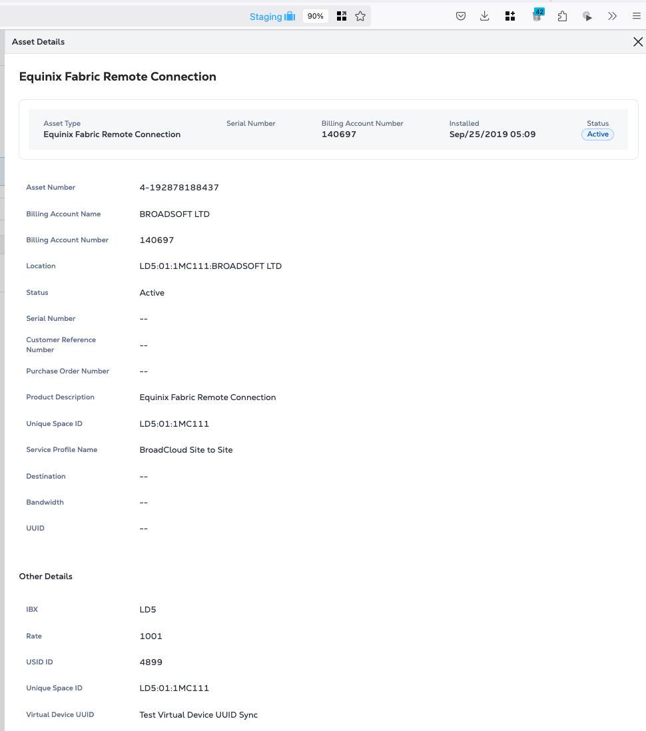
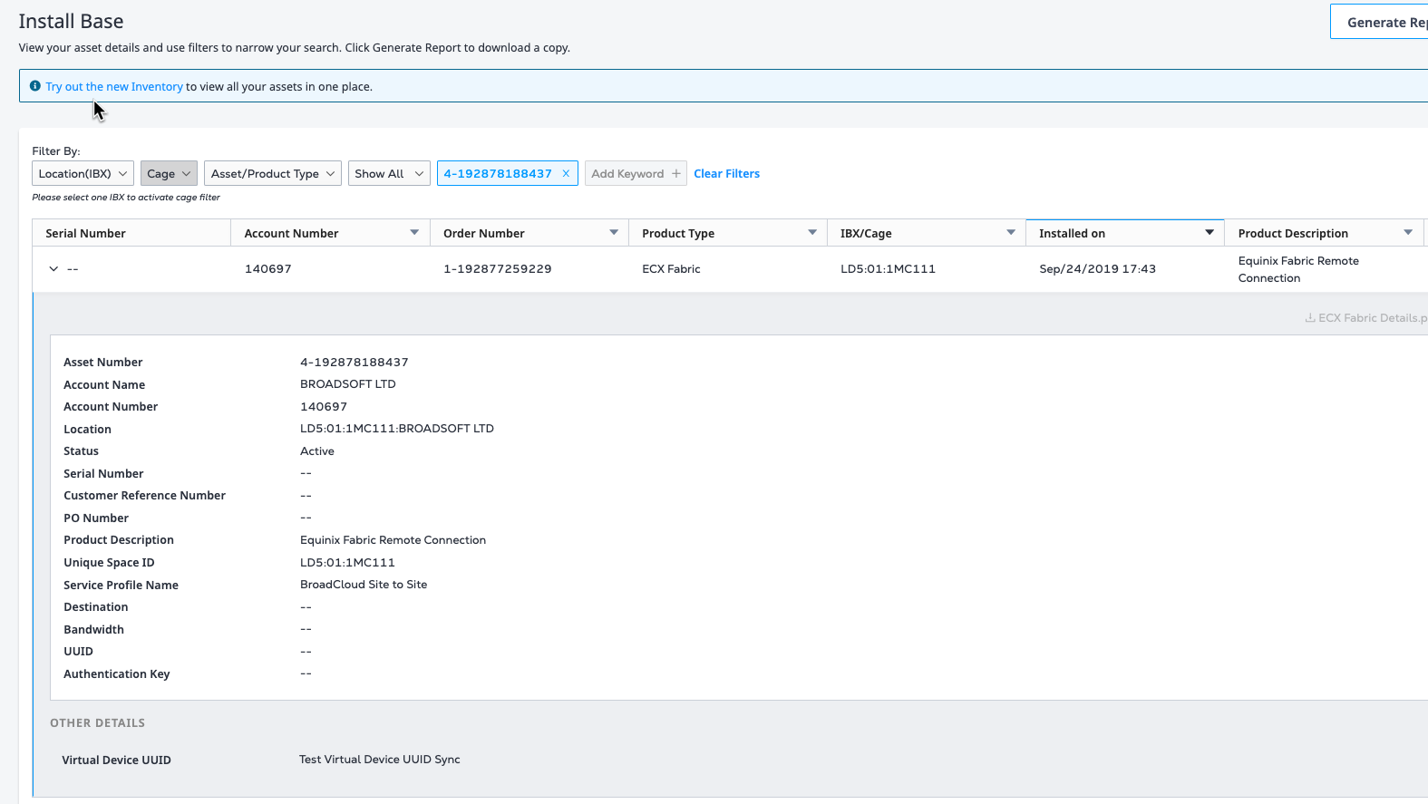
Sample screenshots of Inventory, Install Base UI behavior
For ECX00002.ELEM Fabric Connection, ECX00003.ELEM Fabric Service Provider, ECX00008.ELEM Fabric Remote Connection assets
Inventory
Install Base
No Change. ‘Bandwidth’ label is not mapped to ‘Rate’
No Change. ‘Bandwidth’ label is not mapped to ‘Rate’
No Change. ‘Rate’ label is mapped to ‘Rate’

Slide 16
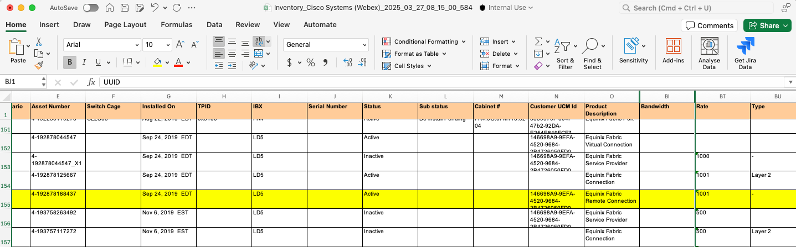
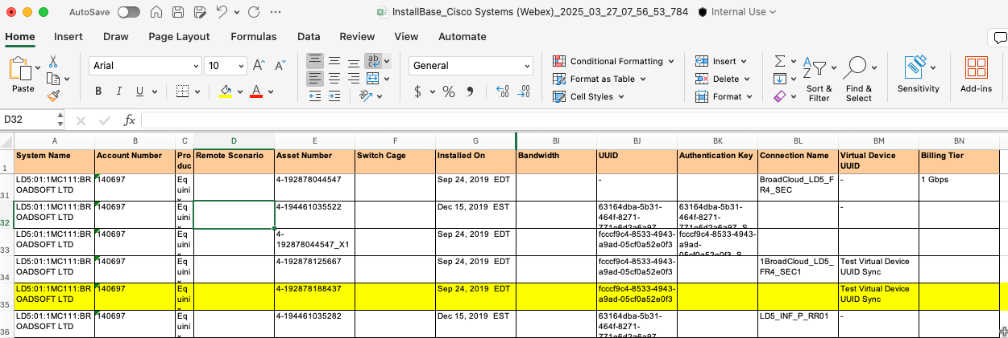
Sample screenshots of Inventory, Install Base Report behavior
For ECX00002.ELEM Fabric Connection, ECX00003.ELEM Fabric Service Provider, ECX00008.ELEM Fabric Remote Connection assets
No Change. 'Rate’ column is mapped to Siebel’s ‘Rate’ attribute
Inventory
Change: ‘Bandwidth’ column is unmapped from Siebel ‘Rate’
Install Base
Change: ‘Bandwidth’ column is unmapped from Siebel ‘Rate’

Slide 17
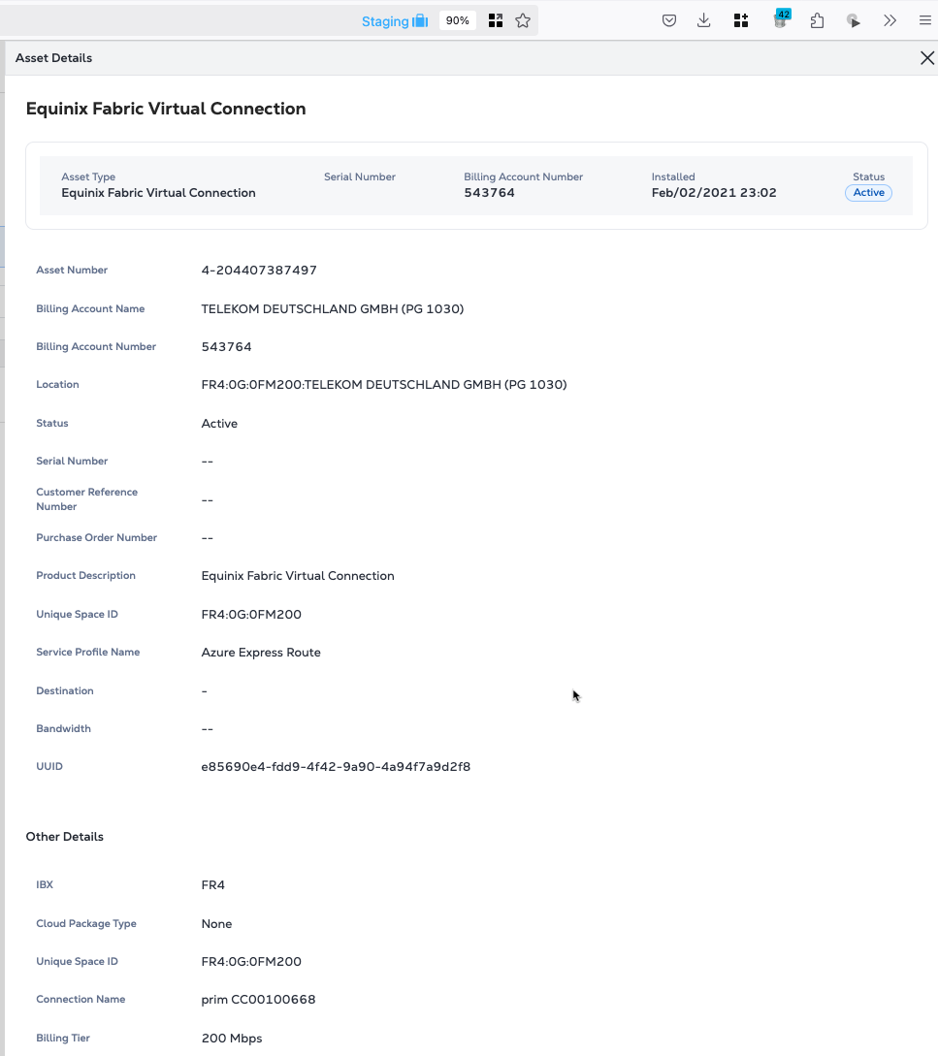
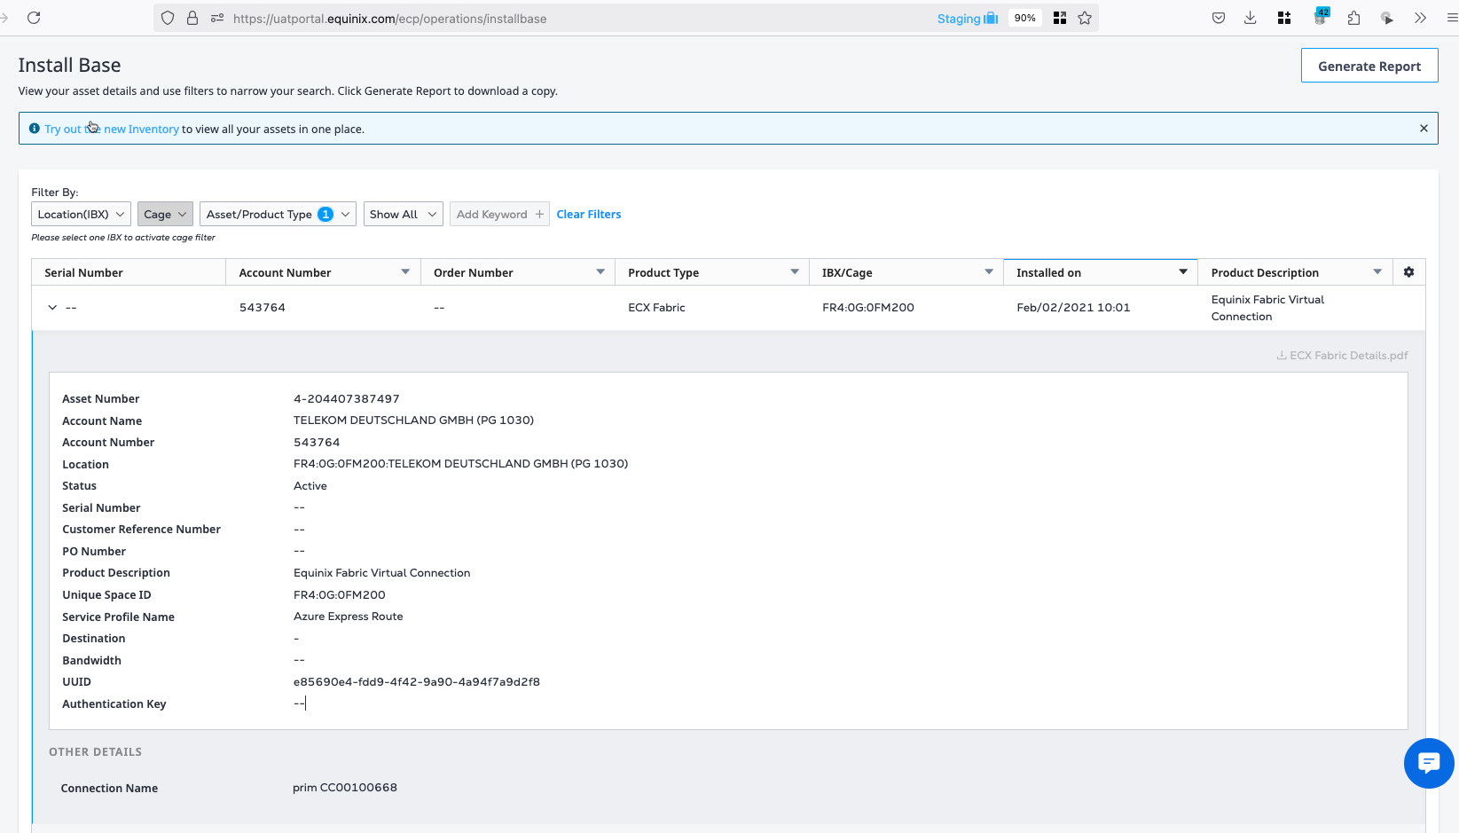
Sample screenshots of Inventory, Install Base UI behavior
For ECX00015.ELEM Fabric Virtual Connection assets
Inventory
Install Base
Change: Bandwidth is unmapped from Siebel's `Connection Speed`
Change: Bandwidth is unmapped from Siebel's `Connection Speed`
Change: new label `Billing Tier` is mapped to Siebel's `Connection Speed`

Slide 18
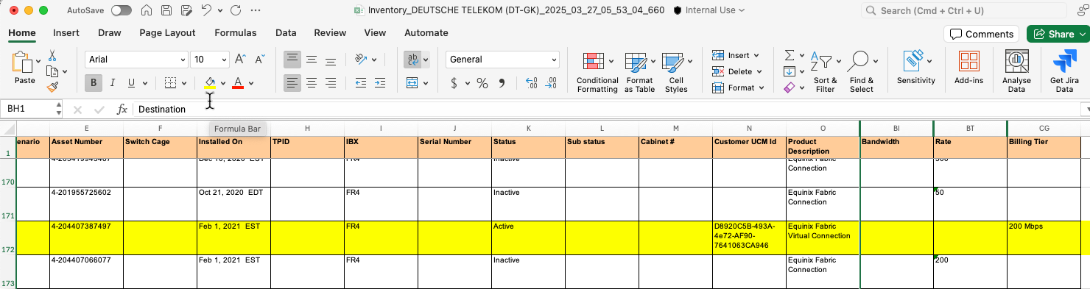
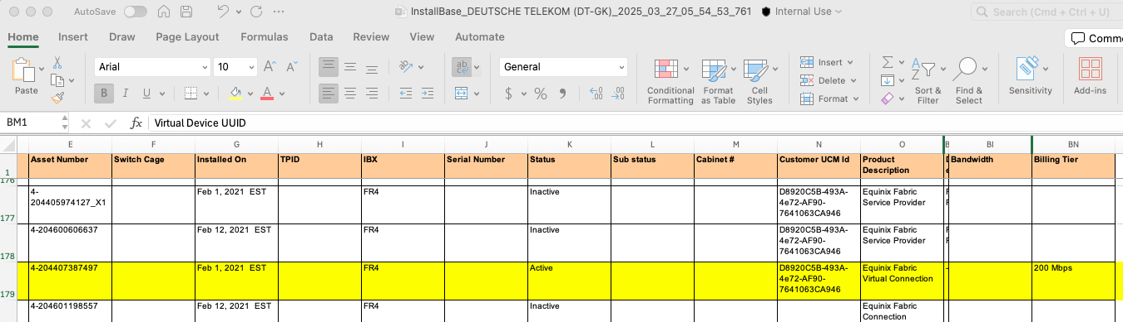
Sample screenshots of Inventory, Install Base Report behavior
For ECX00015.ELEM Fabric Virtual Connection assets
Change: ‘Billing Tier’ column is added and mapped to Siebel ‘Connection Speed’
Change: ‘Bandwidth’ column is unmapped from Siebel 'Connection Speed'
Inventory
Install Base
Change: ‘Bandwidth’ column is unmapped from Siebel 'Connection Speed'

Slide 19
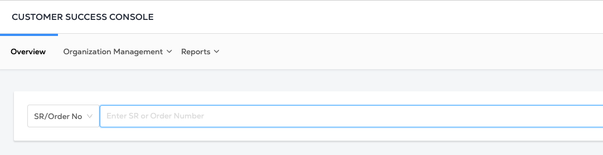
Operator – Allow alphanumeric search in Operator’s Order Number Search
ECP/ Operator | Module | Detail | Training & process change
Operator | Order Number Search | User can enter alphabets into search box Alphanumeric order numbers can be searched and user will land on ECP’s order details page accordingly | CSM Awareness GSD awareness Ops Support awareness Sales/AE awareness

Slide 20
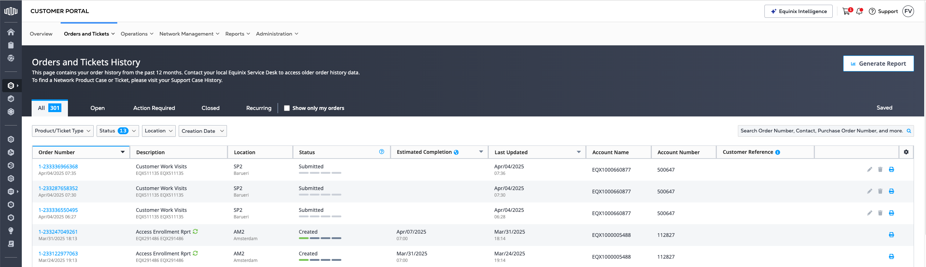
Order History – Update default behaviour when landing on Orders & Tickets History page
ECP/ Operator | Module | Detail | Training & process change
ECP | Order History | Users will be on the “All” tab when they access Orders & Tickets History page Position of “All” tab has been shifted to the first tab of the data table | CSM Awareness GSD awareness Ops Support awareness Sales/AE awareness

Slide 21
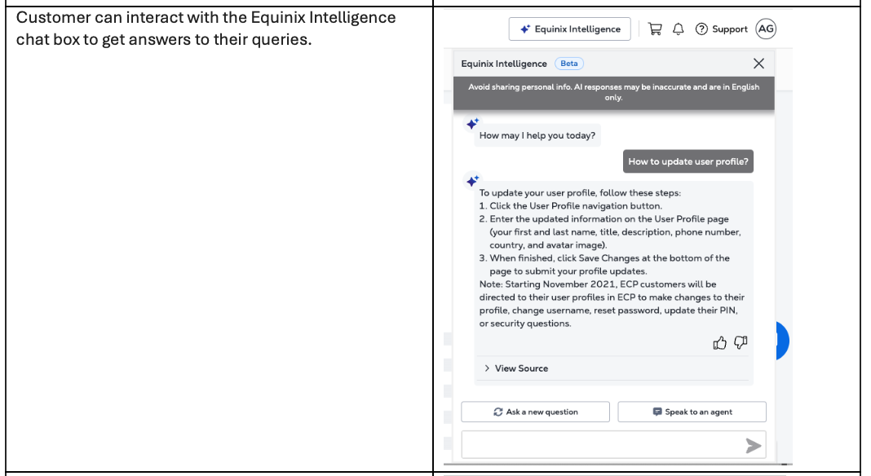
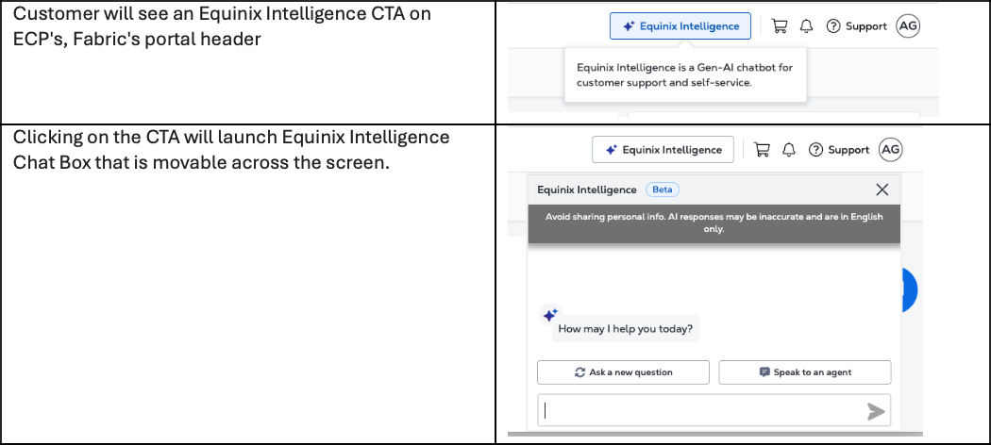
Equinix Intelligence – Pilot launch
ECP/ Operator | Module | Detail | Training & process change
ECP | Equinix Intelligence | Customer will see an Equinix Intelligence CTA on ECP's, Fabric's portal header Clicking on the CTA will launch Equinix Intelligence Chat Box that is movable across the screen. Customer can interact with the Equinix Intelligence chat box to get answers to their queries. (Data source will be from Product Documents inclusive of deploy.equinix.com) Customer can get their own order details information from Equinix Intelligence. (Details which they can already find in their Orders & Tickets History page.) If Equinix Intelligence does not resolve customer's problem, they can trigger the SFDC Live Chat within Equinix Intelligence itself. There is no need to switch to another application and the Live Chat will be managed by GSD as usual. Equinix Intelligence can be minimised into a floating icon that's movable as well. Customer can permanently close the floating icon, Customer can also see any counts of notification received from the GSD Live Agent during live chat session. | CSM Awareness GSD awareness Ops Support awareness Sales/AE awareness

Slide 22
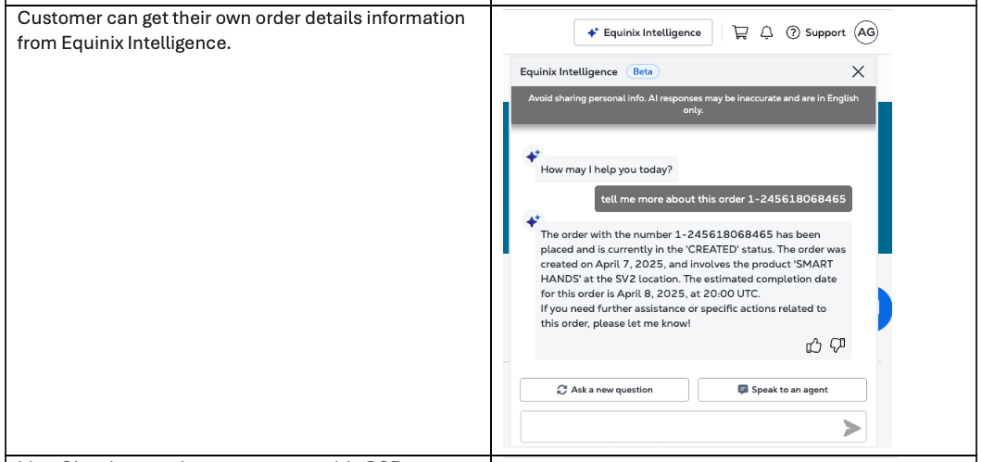
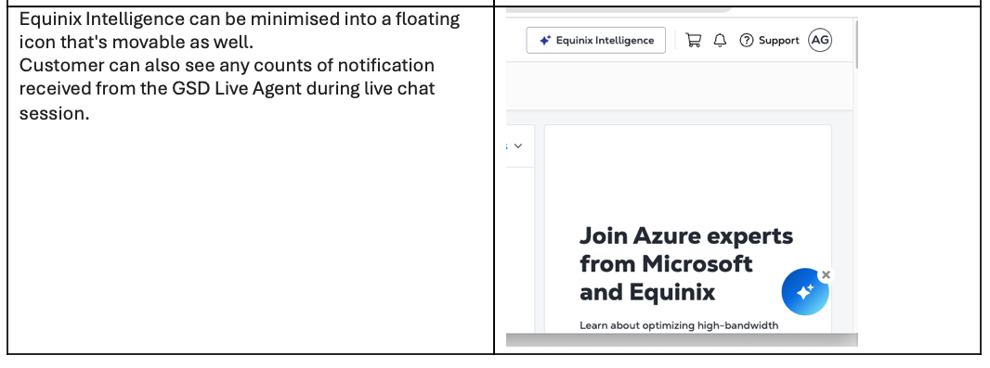
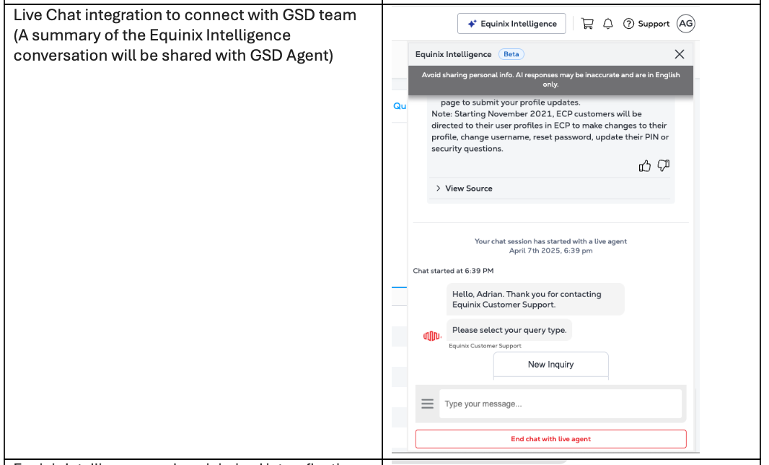
Equinix Intelligence – Pilot launch (continued)
Note : List of pilot customers

Slide 23
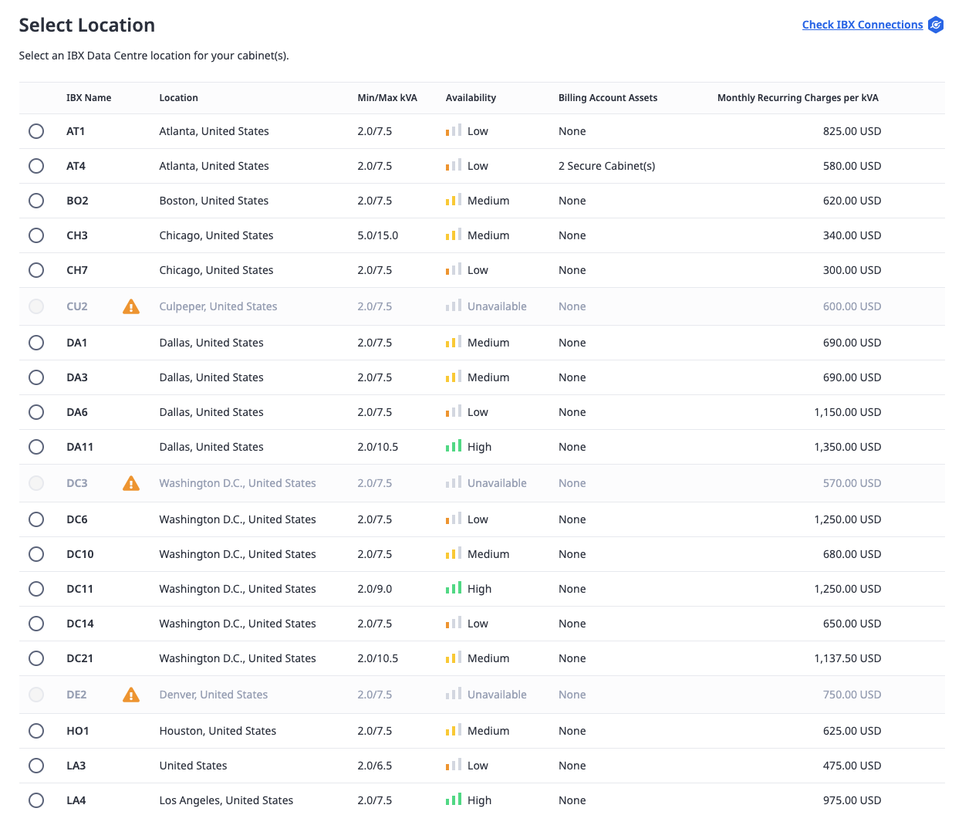
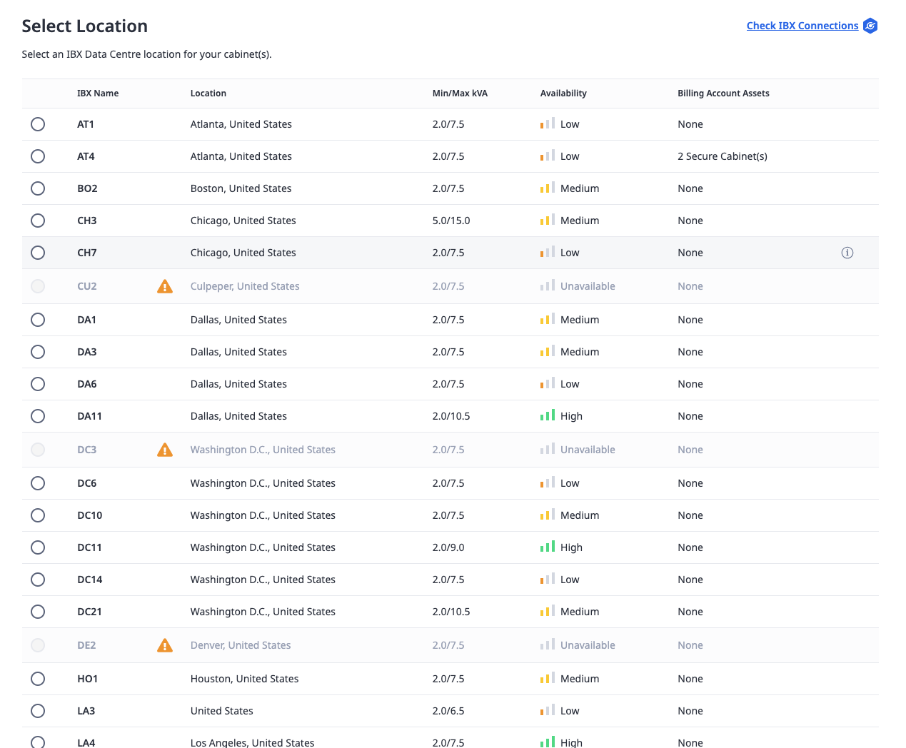
Hiding IBX pricing
Before
After
Training & process change | CSM Awareness GSD awareness Ops Support awareness Sales/ SE awareness

Slide 24
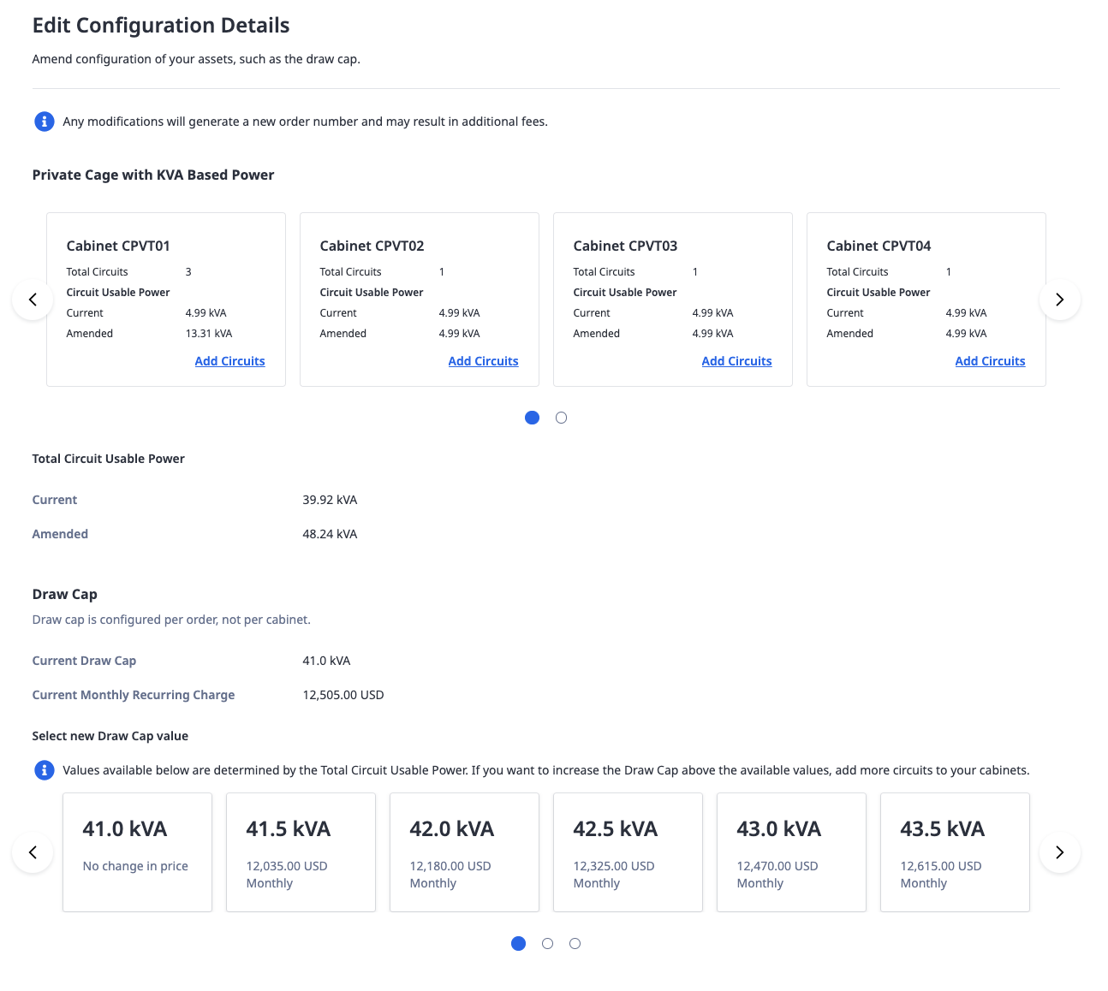
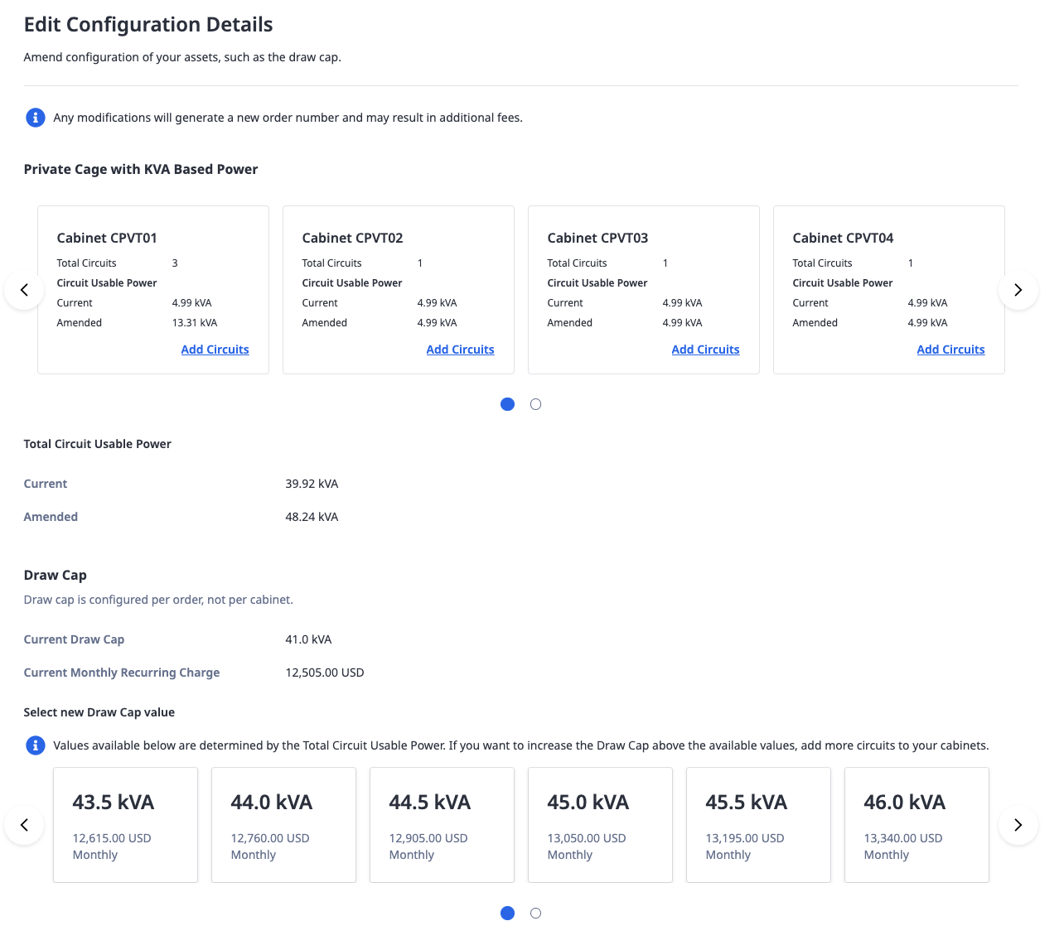
Only increasing MRC on MACDs
Before
After
Training & process change | CSM Awareness GSD awareness Ops Support awareness Sales/ SE awareness

Slide 25
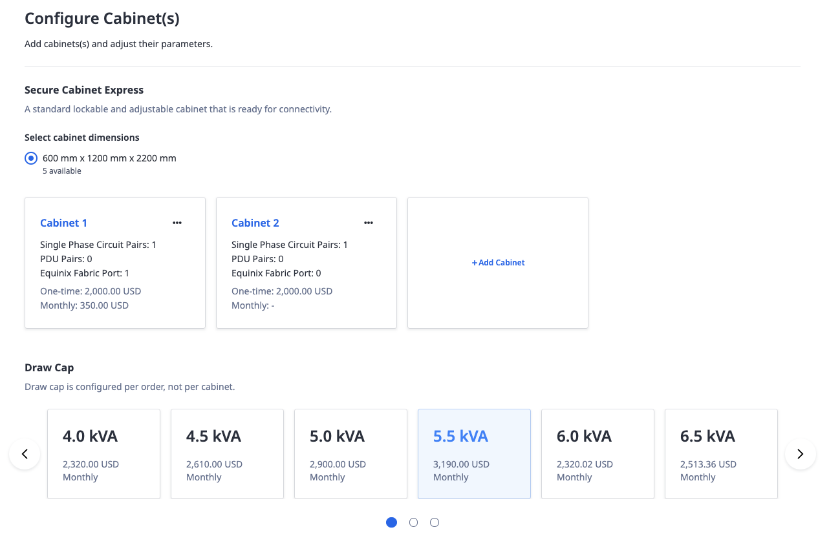
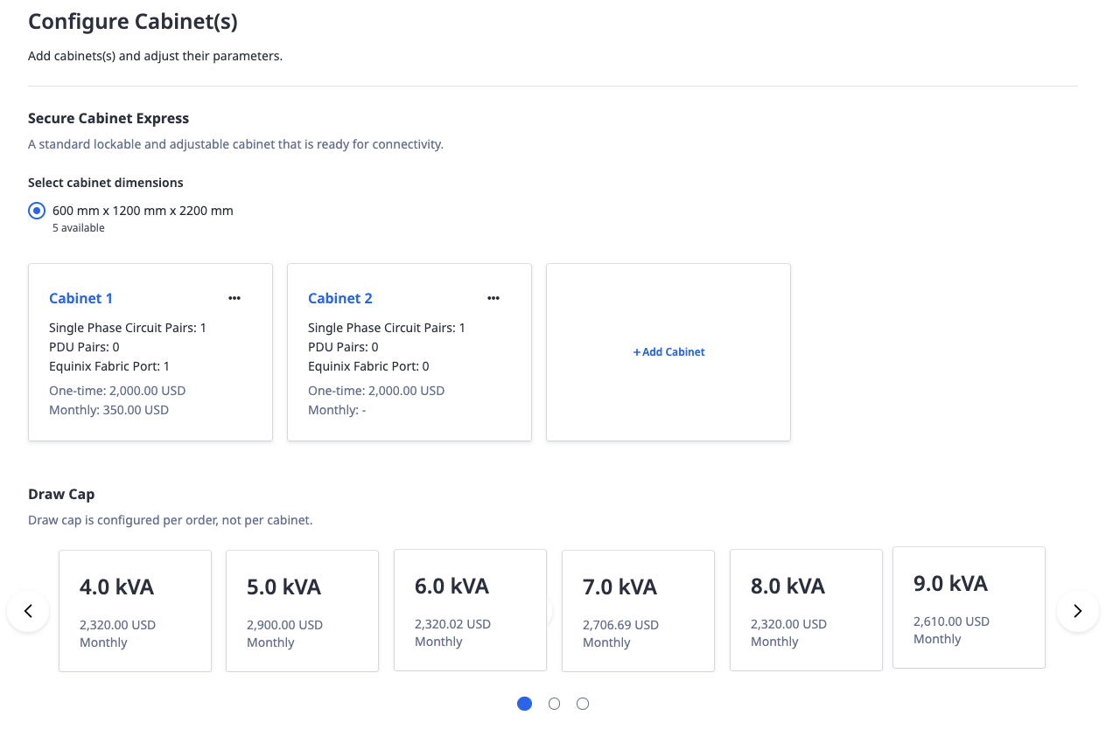
Allow 1kVA draw capacity increments
Before
After
Training & process change | CSM Awareness GSD awareness Ops Support awareness Sales/ SE awareness

